Slide 1
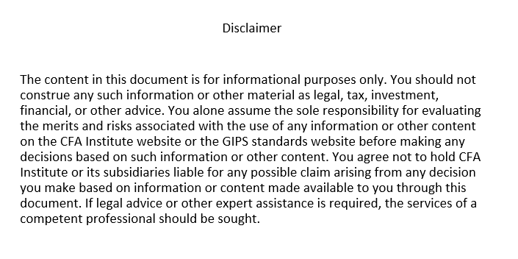

Slide 2
Introduction to the GIPS® Standards for Marketing Teams
Presenter’s Name
Presenter’s Title
DD Month YYYY

Slide 3
agenda
Overview of the GIPS standards
Types of GIPS Reports
Information in GIPS Reports
Who must receive a GIPS Report
Information outside of a GIPS Report
Other information
For US firms only

Slide 4
OVERVIEW OF THE GIPS STANDARDS

Slide 5
What are the GIPS standards and why are they needed?
What are the GIPS standards?
The Global Investment Performance Standards (GIPS®) were created to provide guidance as to how performance should be ethically presented
Voluntary standards created and administered by CFA Institute
Intended for marketing of composite or pooled fund results to prospects
Guidance specific to investment management firms, asset owners, and verification firms
Fill a regulatory gap
In most markets, there is limited regulatory guidance for how a firm should calculate and report performance outside of broadly distributed pooled funds
Beneficial to firms and asset owners
Best practice
Competitive advantage
Equalizes playing field for firms in different jurisdictions
De facto requirement in certain institutional marketplaces

Slide 6
WHICH FIRMS CAN CLAIM COMPLIANCE WITH THE GIPS STANDARDS?
Any firm that manages discretionary assets may claim compliance
Compliance must be on a firm-wide basis

Slide 7
Which FIRMS CLAIM COMPLIANCE?
1,700+ organizations claim compliance with the GIPS standards
Global adoption around the world in more than 40 markets
24 of the top 25 global asset managers claim compliance with the GIPS standards for all or a part of their assets

Slide 8
SECTIONS IN THE GIPS STANDARDS FOR FIRMS
General Provisions
Fundamentals of Compliance
Input Data and Calculation Methodology
Composite and Pooled Fund Maintenance
GIPS Composite Reports
Time-Weighted Returns
Money-Weighted Returns
GIPS Pooled Fund Reports
Time-Weighted Returns
Money-Weighted Returns
8. GIPS Advertising Guidelines

Slide 9
KEY REQUIREMENTS
Fundamentals of Compliance (Section 1)
Several core principles create the foundation for the GIPS standards, including:
Properly defining the firm
Providing GIPS Reports to all prospective clients and prospective pooled fund investors
Adhering to applicable laws and regulations, and
Ensuring that information presented is not false or misleading
Input Data & Calculation Methodology (Section 2)
Consistency of input data used to calculate performance establishes the foundation for full, fair, and comparable investment performance presentations
The GIPS standards require the use of certain calculation methodologies to facilitate comparability

Slide 10
KEY REQUIREMENTS
Composite & Pooled Fund Maintenance (Section 3)
A composite is an aggregation of one or more portfolios managed according to a similar investment strategy
Creating meaningful composites is essential to the fair presentation, consistency, and comparability of performance over time and among firms
The composite return is the asset-weighted average of the performance of all portfolios in the composite
Pooled funds must be included in composites if they meet the composite definition

Slide 11
KEY REQUIREMENTS
GIPS Reports (Sections 4-7)
A GIPS Report is a presentation for a composite or a pooled fund that contains all the information required by the GIPS standards
It may also include recommended information or supplemental information
Includes numerical information (e.g., annual returns for the composite/pooled fund and benchmark, composite and benchmark dispersion, number of portfolios in the composite, composite/pooled fund assets, total firm assets)
Includes a series of disclosures
Must be provided to all prospects

Slide 12
KEY REQUIREMENTS
GIPS Advertising Guidelines (Section 8)
Provides an ability for firms that claim compliance to state that they claim compliance with the GIPS standards outside of a GIPS Report
Firms can choose not to follow the GIPS Advertising Guidelines

Slide 13
Types of pooled funds
The GIPS standards have different requirements for broad distribution pooled funds and limited distribution pooled funds
A broad distribution pooled fund (BDPF) is a pooled fund that is regulated under a framework that would permit the general public to purchase or hold the pooled fund’s shares and it is not exclusively offered in one-on-one presentations
A limited distribution pooled fund (LDPF) is any pooled fund that is not a broad distribution pooled fund

Slide 14
Examples of broad & limited distribution pooled funds
Broad Distribution Pooled Funds
Mutual Funds available to retail and institutional investors (e.g., ‘40 Act Fund, SICAV Fund, UCITS Fund)
Exchange Traded Funds (ETF)
Limited Distribution Pooled Funds
Hedge Funds
Private Equity Funds

Slide 15
TYPES OF GIPS REPORTS

Slide 16
TYPES OF GIPS REPORTS
The term “GIPS Report” includes both GIPS Composite Reports and GIPS Pooled Fund Reports
A GIPS Composite Report is a presentation for a composite that includes all of the information required by the GIPS standards
A GIPS Pooled Fund Report is a presentation for a pooled fund that includes all of the information required by the GIPS standards

Slide 17
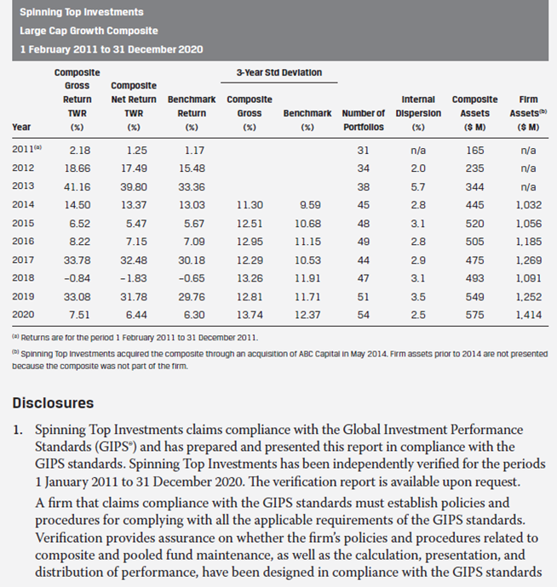
SAMPLE GIPS COMPOSITE REPORT excerpt WITH TIME-WEIGHTED RETURNS

Slide 18
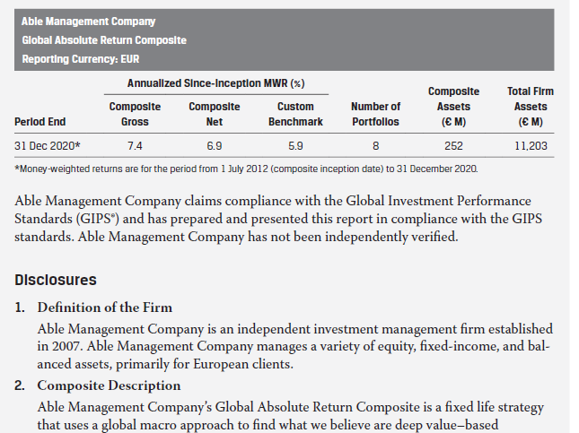
SAMPLE GIPS COMPOSITE REPORT excerpt WITH MONEY-WEIGHTED RETURNS

Slide 19
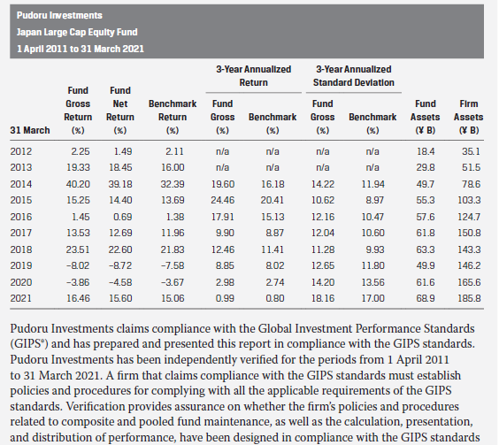
SAMPLE GIPS POOLED FUND REPORT excerpt WITH TIME-WEIGHTED RETURNS

Slide 20
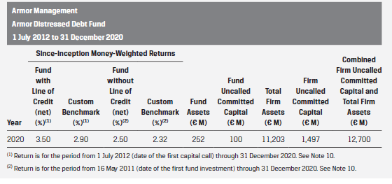
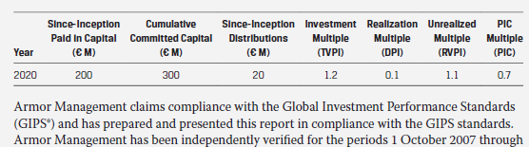
SAMPLE GIPS POOLED FUND REPORT excerpt WITH MONEY-WEIGHTED RETURNS

Slide 21
INFORMATION IN GIPS REPORTS

Slide 22
GIPS Reports
GIPS Reports must include numerical information about the composite or pooled fund for specified periods
For a minimum of 5 years initially, building towards a minimum of 10 years
Required numerical information for a time-weighted return report includes:
Annual composite/pooled fund returns
Gross, net, or both
Annual benchmark returns
Standard deviations of composite/pooled fund and benchmark returns
Number of portfolios in the composite as of each annual period end
Measure of dispersion of annual portfolio returns within the composite for each annual period
Composite/pooled fund assets as of each annual period end
Total firm assets as of each annual period end

Slide 23
GIPS Reports
GIPS Reports must include a series of disclosures, including:
Firm definition
Description of the composite or pooled fund strategy
Benchmark description
Fee schedule
Whether actual or model fees were used to calculate net returns

Slide 24
WHO MUST RECEIVE A GIPS REPORT

Slide 25
PROVIDING GIPS REPORTS
Firms must make every reasonable effort to provide a GIPS Report to all prospective clients and prospective investors for limited distribution pooled funds when they initially become prospects
A prospective client is any person or entity that has expressed interest in one of the firm’s composite strategies and qualifies to invest in the composite strategy
A prospective investor is any person or entity that has expressed interest in one of the firm’s pooled funds and qualifies to invest in the pooled fund
The GIPS Report must represent the strategy/fund being marketed to the prospective client/investor
Investment consultants, consultant databases, and other third parties are considered prospects if they represent individuals or entities that qualify as prospective clients/investors
There is no requirement to provide a GIPS Report to prospects who are interested in a broad distribution pooled fund

Slide 26
Providing GIPS Reports to prospective investors
The GIPS Report provided to a prospective investor who is interested in an LDPF may be either:
A GIPS Pooled Fund Report for the LDPF, or
A GIPS Composite Report, if the LDPF is included in the respective composite

Slide 27
PROVIDING GIPS REPORTS – Sample policy
Prospective Client and Investor
We define a prospective client as any prospect that has expressed interest in a composite strategy and who has at least $1 million to invest in the strategy (minimum amount for onboarding new clients).
We define a prospective investor as any prospect that has expressed interest in a limited distribution pooled fund (LDPF) who qualifies to invest in the LDPF.
Databases and consultants are also considered prospects.
How GIPS Reports are Distributed
The appropriate GIPS Report is included as Exhibit A in all pitch books for composite strategies. The GIPS Report for each LDPF is included as the second page in each fund’s fact sheet. The fund fact sheet is included as an exhibit in each fund’s offering memorandum. The firm does not provide a GIPS Report to BDPF prospective investors.
How GIPS Report Distribution is Tracked
The Marketing Department is responsible for ensuring that all prospective clients and LDPF prospective investors receive a GIPS Report once the prospective client or prospective investor has shown interest in a specific strategy or pooled fund and it is determined that the prospective client or prospective investor is qualified to invest in the strategy (e.g., meets the minimum amount needed to invest in the strategy) or the pooled fund. The Compliance Department keeps a log of all pitch books and offering documents that are provided to prospective clients and prospective investors. The log contains the name of the marketing material, the date of the GIPS Report (e.g., Large Cap Growth Composite as of 31 December 2020), the person/firm that received the GIPS Report, and the date the GIPS Report was provided.

Slide 28
INFORMATION OUTSIDE OF A GIPS REPORT

Slide 29
INFORMATION OUTSIDE OF A GIPS REPORT
Firms are not limited to providing only GIPS-compliant information to prospective clients, prospective investors, or other interested parties
The type of information will determine how and where the information may be used
Some examples of information that could be included outside of a GIPS Report include:
Annualized returns
Rolling returns
Attribution
Contribution to returns
Information specifically requested by a prospect, database, or RFP

Slide 30
FALSE OR MISLEADING INFORMATION
A firm must not present performance or performance-related information that is false or misleading
Applies to all information on a firm-wide basis
Is not limited to materials that refer to the GIPS standards
Misleading performance includes:
Custom benchmark returns reduced by model fees without also presenting composite/pooled fund net returns
Model performance presented as actual performance

Slide 31
LINKED INFORMATION THAT IS NOT ALLOWED IN GIPS REPORTS
The following is linked information that may not be used in GIPS Reports:
Actual performance linked to model performance
Non-portable performance linked to ongoing results
Portable performance linked to ongoing results when there was a break
Non-compliant data after the minimum effective compliance date

Slide 32
LINKED INFORMATION THAT IS NOT ALLOWED IN GIPS REPORTS
The linked information that is not allowed in GIPS Reports may be provided to prospects outside of a GIPS Report if it is:
Used in a one-on-one presentation created for a prospect, when requested by the prospect
Used in a one-on-one presentation that includes a GIPS Report (if GIPS Report was not previously provided)
Presented only to prospects that the firm believes are sufficiently knowledgeable about investments and can understand the relevance and limitations of the track record being presented
Sufficiently disclosed
Not presented if a GIPS-compliant track record is requested
Not included in a consultant database

Slide 33
OTHER INFORMATION

Slide 34
MATERIAL ERROR
A firm must correct material errors in GIPS Reports and must provide the corrected GIPS Report to certain parties who received the GIPS Report that had the material error
An error, which can be qualitative or quantitative, is any component of a GIPS Report that is missing or inaccurate
Firms are required to create error correction policies that include criteria for how material errors will be treated, and must follow those policies consistently
A firm’s error correction policies are limited to errors in GIPS Reports and do not extend to other materials

Slide 35
Proper references to the GIPS standards
Firms wishing to make reference to their claim of compliance with the GIPS standards may do so:
In a GIPS Report, or
In a GIPS Advertisement
GIPS Reports and GIPS Advertisements include specific language the firm must include when making reference to the GIPS standards

Slide 36
FOR FIRMS THAT ARE SUBJECT TO FINRA AND US SEC REGULATIONS

Slide 37
FINRA Regulatory Notice 20-21
Applies to private placement offerings for retail investors when a firm wishes to include IRRs for funds that are ongoing and have not fully liquidated
Retail investor is defined as an entity with $50 million or less in investable assets
Requires firms to present performance and other metrics that are consistent with the GIPS standards
For funds that use subscription lines of credit, SI-IRRs must be shown with and without the subscription line of credit. Returns without the subscription LOC are not required when:
The principal on the subscription LOC was repaid within 120 days using committed capital drawn down through a capital call; and
No principal from the subscription LOC was used to fund distributions
GIPS Pooled Fund Reports contain all of the information required by FINRA Reg Notice 20-21

Slide 38
SEC Marketing Rule – Related Performance
“Related performance” is the results of one or more “related portfolios”
Either on a portfolio-by-portfolio basis or as a composite aggregation of all related portfolios
Related portfolio is a portfolio with substantially similar investment policies, objectives, and strategies as those of the services being offered in the advertisement
SEC Marketing Rule prohibits an advertisement from including related performance unless it includes all related portfolios. However, related performance may exclude any related portfolios as long as:
the advertised performance results are not materially higher than if all related portfolios had been included, and
the exclusion of any related portfolio does not alter the presentation of applicable prescribed time periods (i.e., 1-, 5-, and 10-year returns)
Determination of whether a portfolio is a related portfolio is a facts and circumstances analysis
Consider investment objectives, material client constraints and differences
Do not consider fees and expenses
SEC Marketing Rule specifically references the GIPS standards as an acceptable framework for determining which portfolios are related portfolios

